Slide 1

Automatic Defect Detection System for Finished Leathers using Deep Learning
VIVA VOICE
07-06-2022
Supervisor: Dr P Anandan
Designation: Associate Professor
TEAM MEMBERS :
K.S.MURALI -VTU11217
M.NAVEEN-VTU12731
V.AKSHAY-VTU14212

Slide 2
CONTENTS
1
ABSTRACT
OBJECTIVE
INTRODUCTION
LITERATURE SURVEY
PROPOSED METHOD
BLOCK DIAGRAM
METHODOLOGY
RESULT AND ANALYSIS
SOFTWARE USED
PROJECT PLAN
REFERENCES
PAPER SUBMISSION PROOF

Slide 3
ABSTRACT
2
Leather is a very important raw material in many manufacturing industries. India is the second largest exporter of leather garments, 4th largest exporter of Leather Goods in the world.
Leather is a natural and durable material created through a process of tanning of hides and skins of animals. The price of the leather is subjective as it is highly sensitive to its quality and surface defects condition.
Prior to the mass production of certain product there are very few works investigating on the defects detection for leather. The manual defect inspection process is essential in an leather production industry as the quality control step.
However, it is tedious, as it is labour intensive, time consuming, causes eye fatigue and often prone to human error.
In This Project, a fully automatic defect detection system using Convolutional Neural Network for finished leathers is proposed to provide the defect free leathers.
Then, a series of processes are conducted to predict the defect instances, including elicitation of the leather images with a camera, train and test the images using a deep learning architecture and determination of the boundary of the defects using mathematical derivation of the geometry.
Key words : leather,defect,architecture,training and testing

Slide 4
OBJECTIVE
3
The project aims to detect the defects in finished leathers with more detection accuracy.
To reduce the inspection time compared to human inspection and can give more significant results on defect detection in leather industry.

Slide 5
INTRODUCTION
4
The Indian Leather and Leather Products holds a prominent place in the Indian economy. The Leather industry in India accounts for around 13% of the world's leather production of hides/skins and handles a robust annual production of about 3 bn sq. ft. of leather.
Because of the importance of leather in the manufacturing industry, it is vital to ensure the good quality of the leather to improve customer satisfaction.
Normally, the Quality of raw material is affected either by ante-mortem defects (scratches, rub marks, horn rake, yoke mark, scabies, pox, brand marks etc) or post-mortem defects (flay cuts, fleshing cuts, grain crack).
In fact that the quality of the raw hide and skin plays a decisive role in the quality of the produced leather and it constitutes about 50 – 70% of the cost of production, the raw material is the most valuable and important of the production elements.
The grading process is one of the most critical and exhausting procedures because it involves a manual assessment to visually inspect the defective parts of the leather. particularly, the type of defect, the defective size, and the severity level are the major aspects of quality control.

Slide 6
INTRODUCTION (continued…)
5
The inspectors require to conduct a thorough manual evaluation on the same piece of leather multiple times, viewing from multiple angles, distances, and lighting conditions to ensure the correctness and completeness.
However, it should be noted that each judgment is subjective as it highly relies on the individual. thus, human inspection is costly, time-consuming, inefficient, and inconsistent.
It can prone to human mistakes or errors due to this boring and repetitive task, or when the labor is feeling stressed and rushing to complete the task.
Therefore, there is vital to design an automatic leather defect inspection system in order to improve the grading and inspection processes, in the meantime cutting off unnecessary costs.
The final goal of this project is to classify the finished leather sample into either defective and non defective.

Slide 7
LITERATURE SURVEY
6
S. NO | TITLE OF THE PAPER | AUTHORS | YEAR & VOLUME | JOURNAL NAME | OBSERVATION WITH PERFORMANCE METRICS
1 | Automated Classification System for Tick-Bite Defect on Leather | Y. S. Gan,Wei-Chuen Yau,Sze-Teng Liong , and Chih-Cheng Chen | 2022 & volume 22 | Mathematical Problems in Engineering | Classification accuracy obtained is 94% by using ANN classifiers, this experiment strictly limited to the defect type of tick-bite defect,
2 | Leather defect classification and segmentation using deep learning architecture | Sze-Teng Liong , Danna Zheng , Yen-Chang Huang & Y. S. Gan | 2020 & volume 33 | International Journal of Computer Integrated Manufacturing | There are three types of experimental configurations for the train/ test data distribution in classifying the defective images. By employing AlexNet, the accuracy and F1- score results obtained it is also noticed that all the cases are capable to produce the results of more than 90%.
3 | On the Application of Automated Machine Vision for Leather Defect Inspection and Grading: A Survey | MASOOD ASLAM, TARIQ M. KHAN, (Member, IEEE), SYED SAUD NAQVI , GEOFF HOLMES, AND RAFEA NAFFA | 2019 & volume 7 | IEEE access | A detailed review of the role of deep learning methods in general visual inspection applications was presented, where recent CNN architectures are classified and compared.

Slide 8
LITERATURE SURVEY
7
S. NO | TITLE OF THE PAPER | AUTHORS | YEAR & VOLUME | JOURNAL NAME | OBSERVATION WITH PERFORMANCE METRICS
4 | A Novel Framework for Classifying Leather Surface Defects Based on a Parameter Optimized Residual Network | JIEHANG DENG 1,2, JIAXIN LIU 1 , CHANGZHENG WU 1 , TAO ZHONG 1 , GUOSHENG GU 1 , AND BINGO WING-KUEN LING 3 , (Senior Member, IEEE) | 2020 & volume 8 | IEEE access | The proposed framework first obtains the UHD leather images through the UHD leather imaging system. Second, the volume of the data set is expanded to an appropriate scale by applying a sliding patch window on the original UHD images to avoid the overfitting of the insufficient samples. The classification accuracy of the applied reaches 94.6%.
5 | Automated leather defect inspection using statistical approach on image intensity | Y. S. Gan,Sue‑Sien Chee,Yen‑Chang Huang,Sze‑Teng Liong,Wei‑Chuen Yau2 | 2020 & volume 24 | SPRINGER Verlag GmbH Germany, part of Springer Nature 2020 | Several widely known classifiers are selected, which are: SVM, kNN, decision tree, ensemble classifier, logistic regression, and Naive Bayes. The evaluation metrics of the model is then determined using a 70/30 for the train/test split
6 | Vision based inspection system for leather surface defect detection using fast convergence particle swarm optimization ensemble classifier approach | Malathy Jawahar, N. K. Chandra Babu, K. Vani L. Jani Anbarasi, S. Geeth. | 2020 & volume 80 | SPRINGER r Science+Business Media, LLC, part of Springer Nature 2020 | Most prominent features for automatic leather defects were selected using correlation coefficient and test. Extracted features were given as input to different supervised classifiers namely Neural Network (NN), Decision Tree (DT), SVM, Naïve Bayes, KNN and Random Forest (RF) were employed to classify defective and normal regions of the leather image

Slide 9
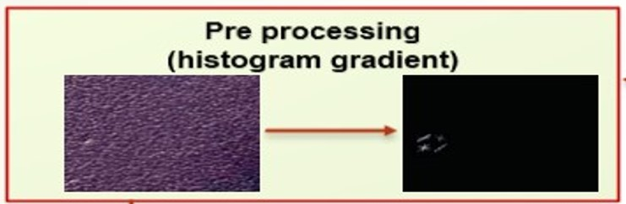
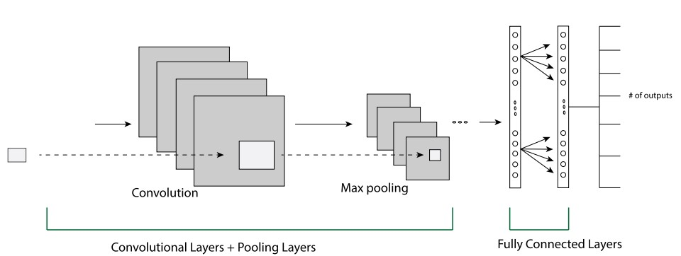
PROPOSED METHOD
8
There are two major steps proposed in the algorithm, namely, the preprocessing and classification. The process is portrayed in block diagram.
Concisely, the images are first passed to preprocessing steps, such as histogram of the gradient .On the other hand, the classification task employs state-of the-art supervised classifier such as Convolutional Neural Networks(CNN).
PREPROCESSING PROCEDURE:
The preprocessing technique employed in the experiment are shown in Figure 1.In addition, sample images are shown to illustrate the effect in preprocessing step.
CLASSIFICATION PROCEDURE:
CNN’s structure consists of a layer of input, a layer of output and several hidden layers sandwiched between layers of input and output. The hidden layers consist of convolutional layers, max-pooling layers, and layers that are fully connected. The general architecture is shown in Figure 2.
Fig 1
Fig 2

Slide 10
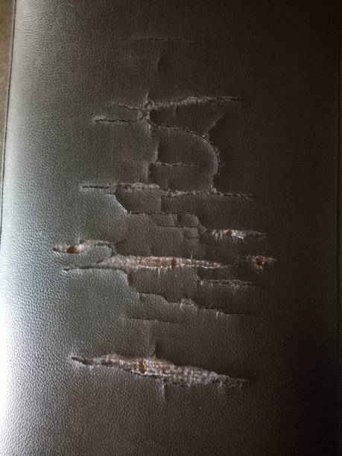
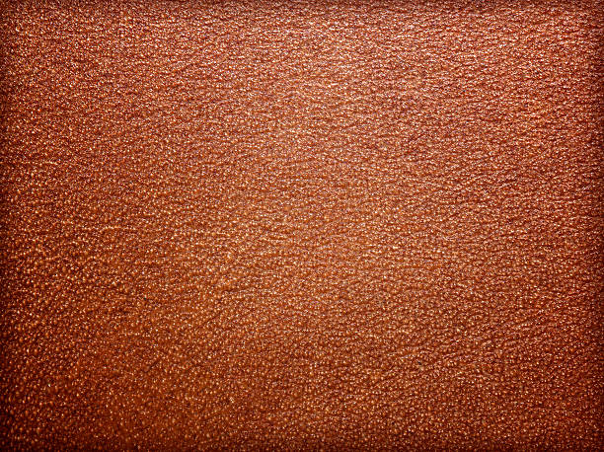

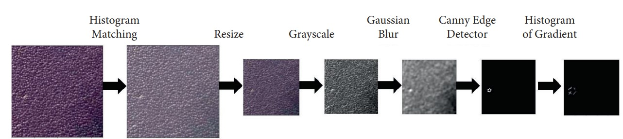
BLOCK DIAGRAM
9
Image Acquisition
Pre processing
(histogram gradient)
Convolutional neural network(CNN)
OUTPUT
Defective
Non-Defective

Slide 11
METHODOLOGY
10
The proposed automated visual defect inspection system comprised of four stages:
Collecting the leather dataset
Pre processing the input images using histogram gradient technique
Deep learning architecture(CNN) training and testing.
Highlighting the defect and making the decision.

Slide 12
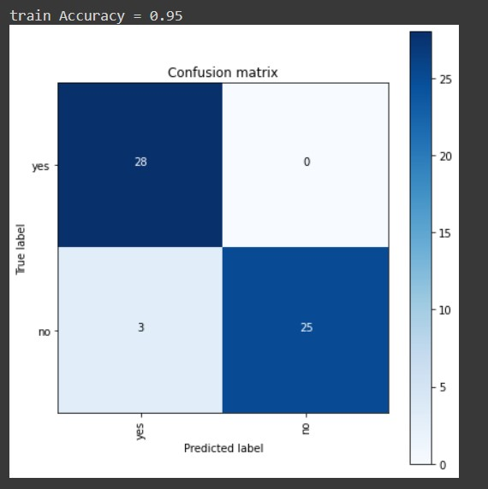
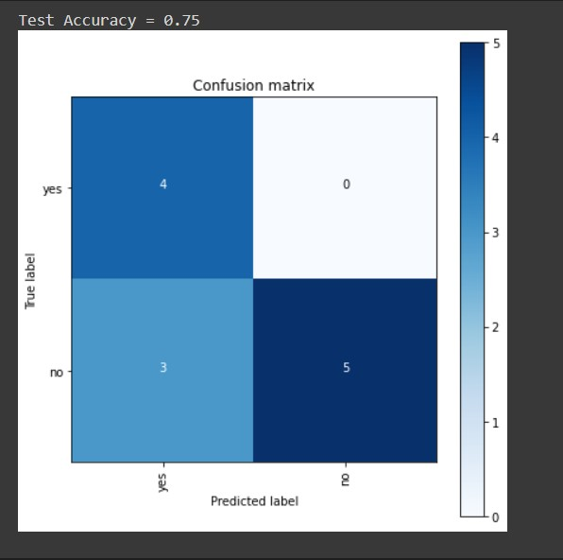
RESULT ANALYSIS
11
Performance metrics | Obtained Train dataset(%) | result Test dataset(%)
precision | 0.57 | 1.00
recall | 1.00 | 0.62
F1-score | 0.73 | 0.77
Accuracy | 0.75
Performance parameters for our proposed method

Slide 13
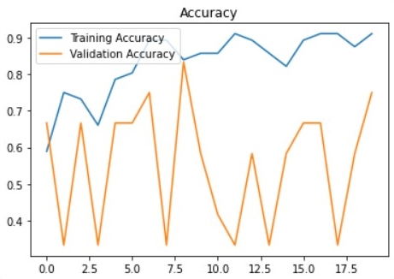
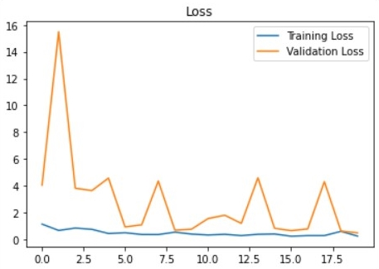
RESULT & ANALYSIS
12
True positive rate
True positive rate
False positive rate
False positive rate

Slide 14
RESULT & ANALYSIS
This work provided a binary classification method to determine whether a leather picture contains a defect or not. Extensive tests and analysis were performed to validate the resilience of the suggested technique.
Overall, when preprocessing approach and neural network classifier used, good results are obtained. As a consequence, when CNN is used as classifier, the best classification accuracy attained is 95 percent.
Because this experiment was confined to the defect type, further study in this area might involve the construction of a classification or segmentation system to detect the defect kinds such as scratches, closed scratches, wrinkles, hovels, and itch.
In addition to evaluating the fault type, the experiment may be expanded to test different leather types such as lamb, crocodile, and snake hides.
In the future, a completely automated hardware setup consisting of the tasks of acquiring leather image patches, recognizing problematic spots, and laser cutting of the leather can be built.

Slide 15


SOFTWARE USED
13
Google Colab and Jupyter notebooks can illustrate the analysis process step by step by arranging the stuff like code, images, text, output etc. in a step by step manner.

Slide 16
PROJECT PLAN
14
S.NO | Project Activity | Description | Status of the work
1 | Study of the project area and problem statement | Detailed study of the project area and understanding the problem statement | Completed
2 | Literature survey | Literature survey on Automatic Defect Detection System for Finished Leathers using Deep Learning | Completed
3 | Methodology and Simulation | Case study and simulation Using Deep Learning | Completed
4 | Implementation | Implementation of Code | Completed
5 | validation | Taking pictures of finished leathers using camera | On Progress
6 | Documentation and Publication Work | Completion of the project and documentation work | Work is completed and about to publish the Paper in journal

Slide 17
REFERENCES
15
Y.S.Gan,Wei-Chuen Yau,Sze-Teng Liong,and Chih-Cheng Chen “Automated Classification System for Tick-Bite Defect on Leather”, Mathematical Problems in Engineering, Volume 22, Article ID 5549879 (2022).
M. Aslam, T. M. Khan, S. S. Naqvi, G. Holmes, and R. Naffa, “On the application of automated machine vision for leather defect inspection and grading: a survey,” IEEE Access, vol. 7, Article ID 176065, (2019)
M. Jawahar, N. K. Babu, K. L. J. A. Vani, L. J. Anbarasi, and S. Geetha, “Vision Based Inspection System for Leather Surface Defect Detection Using Fast Convergence Particle Swarm Optimization Ensemble Classifier Approach,” Multimedia Tools and Applications, vol. 80, no. 3, pp. 4203–4235, (2020).
S. T. Liong, Y. S. Gan, Y. C. Huang, C. A. Yuan, and H. C. Chang, “Automatic Defect Segmentation on Leather with Deep Learning,” March 2019, https://arxiv.org/abs/1903. 12139,(2019)
Y. Gan, S.-S. Chee, Y.-C. Huang, S.-T. Liong, and W.-C. Yau, “Automated leather defect inspection using statistical approach on image intensity,” Journal of Ambient Intelligence and Humanized Computing, vol. 12, pp. 1–17, (2020).

Slide 18
REFERENCES
16
JIEHANG DENG,JIAXIN LIU,CHANGZHENG WU1,TAO ZHONG1 , GUOSHENG GU 1 , AND BINGO WING-KUEN LING 3 , (Senior Member, IEEE),” A Novel Framework for Classifying Leather Surface Defects Based on a Parameter Optimized Residual Network”, volume 8. IEEE access (2020)
MASOOD ASLAM, TARIQ M. KHAN, (Member, IEEE), SYED SAUD NAQVI , GEOFF HOLMES, AND RAFEA NAFFA,“Ensemble Convolutional Neural Networks With Knowledge Transfer for Leather Defect Classification in Industrial Settings”,volume 8 IEEE Access,(2020).
Prahar M. Bhatt, Rishi K. Malhan,Pradeep Rajendran, Shantanu Thakar“Image-Based Surface Defect Detection Using Deep Learning”, Journal of Computing and Information Science in Engineering,volume 21,(2021)
Edmilson Q. Santos Filho,Pedro Henrique Feijó de Sousa,Pedro P. Rebouças Filho2 · Guilherme A. Barreto,Victor Hugo C. de Albuquerque. “Evaluation of Goat Leather Quality Based on Computational Vision Techniques”,Springer (2019).
Sze-Teng LIONG, Y.S. GAN , Kun-Hong LIU, Tran Quang BINH, Cong Tue LE, Chien An WU, Cheng-Yan YANG , Yen-Chang HUANG. “Efficient Neural Network Approaches for Leather Defect Classification”,ARXIV (2019).

Slide 19
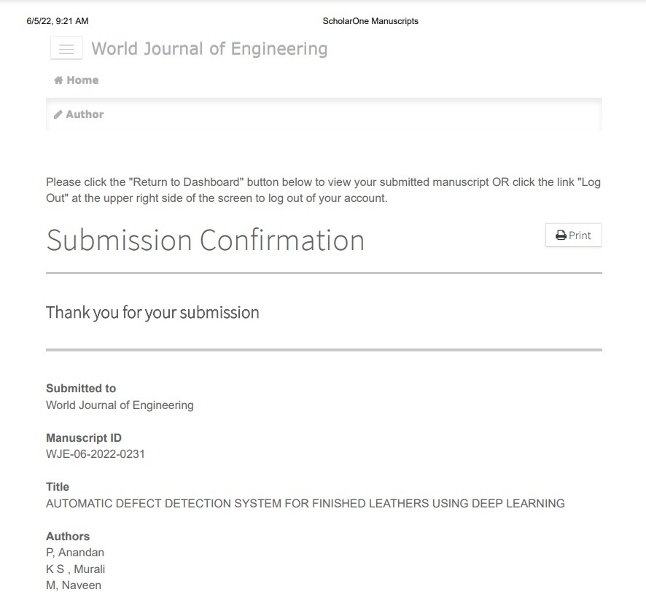
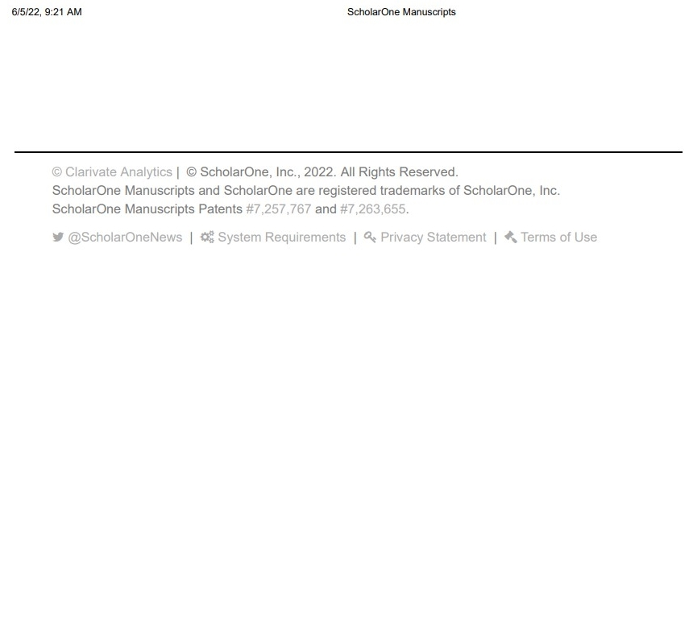
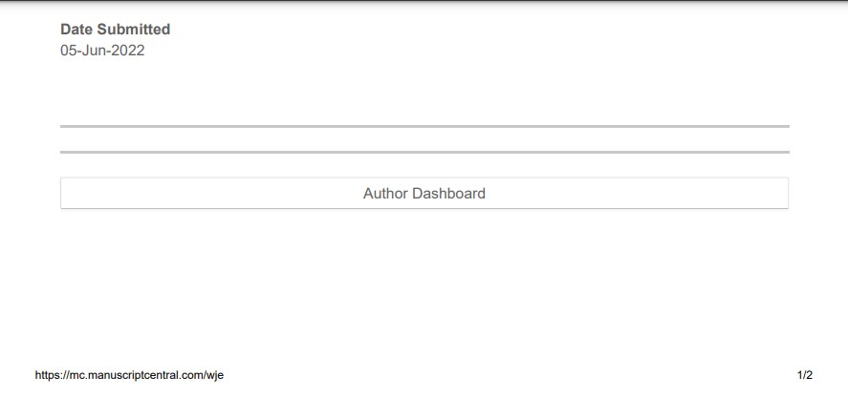

Slide 20


